Slide 1
Silicon Valley Chapter
American Association of Individual Investors
Financial Planning Workshops
Investing … Part 2
www.siliconvalleyaaii.org/financialplanning/
Email: dstikes.svaaii@gmail.com

Slide 2
Disclaimer
The AAII Silicon Valley Chapter and its directors offer their social media and website pages for educational purposes only.
The opinions expressed here are not necessarily those of AAII or the AAII Silicon Valley Chapter, whose only intent is to provide a background for understanding investment, personal finance and wealth management theory and practice.
Nothing on these sites should be considered solicitations or offers to buy or sell any financial instrument or specific trading advice for individuals.

Slide 3
Silicon Valley Chapter
American Association of Individual Investors
Please check us out!
Chapter website: www.siliconvalleyaaii.org
Meetups: www.meetup.com/AAII-Silicon-Valley-Meetup
Facebook: www.facebook.com/sv.aa
Slides and Recordings
www.siliconvalleyaaii.org/financialplanning/
AAII National website: www.aaii.com
My email address: dstikes.svaaii@gmail.com

Slide 4
Our Next Event and Special Interest Group Webcasts
November Main Event: End Year Planning and Tax Efficient Retirement Strategies with Claudia Hill, EA, Saturday November 11th at 9:00am; webcast only
Financial Planning Discussion Group
  Debra Stikes: Second Wednesday of each month at 6:30pm
Investing Discussion Group
  Lynn Gillette: Fourth Monday of each month except December at 6:30pm
Computerized Investing Group
  Bill Paseman, Don Mauer: First Thursday of each month at 6:30pm

Slide 5
Financial Planning Workshops
We cover a full range of topics in the cycle:
Financial Planning … The Big Picture
Investing 1: Modern Portfolio Theory, Building a diversified portfolio
Investing 2: Efficient Market Hypothesis; Can you beat the market?
Taxes: TRJA, SECURE Act, Tax diversification, Asset location, QCDs
Retirement Planning 1: Tax-advantaged plans, RMDs
Retirement Planning 2: Safe withdrawal rates, Bengen’s 4% rule
Risk Management/Insurance: Annuities, Long-term care, Litigation
Social Security and Medicare: Claiming strategies, Medicare traps
Estate Planning: Probate, Executor/trustee duties, Philanthropy
Wrap-up: Case study reviewing previous material

Slide 6
Overview for Today’s Workshop
Recap of Investing Part 1 last month
The Efficient Market Hypothesis
The Capital Asset Pricing Model
Active versus passive investment strategies
Deciding which strategy is appropriate for you

Slide 7
Recap of Investing Part 1
The 5-step investing process
  PIP, IPS, Portfolio design, execution, review
Asset class characteristics
  Cash and equivalents, fixed income, equities
Modern Portfolio Theory
  Risk, return, correlation coefficient
Building simple multi-asset portfolios
  90% bond index / 10% stock index
  30% bond index / 70% stock index
  Lazy portfolios, Life Strategy funds, Target date funds

Slide 8
Simple 2-Asset Portfolio
Total US Bond Market / Total US Stock Market
1986 – 10/2023 37 years | CAGR | Standard Deviation | Best Year | Worst Year | Sharpe Ratio
80% Bonds 20% Stocks | 6.23% | 4.84% | 21.7% | -14.52% | 0.67
60% Bonds 40% Stocks | 7.39% | 7.01% | 25.22% | -15.79% | 0.63
40% Bonds 60% Stocks | 8.44% | 9.68% | 28.74% | -20.20% | 0.58
20% Bonds 80% Stocks | 9.37% | 12.56% | 32.26% | -28.62% | 0.54

Slide 9
Vanguard Life Strategy Funds
Jan 1994 – Oct 2023 29 years | CAGR | Standard Deviation | Best Year | Worst Year | Sharpe Ratio
Income, VASIX 80% Bnds / 20% Stks | 5.36% | 4.88% | 22.99% | -13.93% | 0.64
Conserv Growth, VSCGX 60% Bnds / 40% Stks | 6.22% | 7.22% | 24.35% | -19.52% | 0.57
Mod Growth, VSMGX 40% Bnds / 60% Stks | 7.14% | 9.95% | 27.94% | -26.5% | 0.52
Growth, VASGX 20% Bnds / 80% Stks | 7.76% | 12.84% | 29.24% | -34.39% | 0.47

Slide 10
The Efficient Market Hypothesis, EMH
Popularized by Eugene Fama
  Ph.D dissertation in 1960s
Security prices fully reflect all available information
Stocks always trade at their “fair value”
Consistent alpha generation is impossible

Slide 11
Three Forms of the EMH
Weak form
  All information in past trading history
  Technical analysis cannot provide excess returns
Semi-strong form
  Prices adjust rapidly to release of new information
  Fundamental analysis cannot provide excess returns
Strong form
  All information including insider information
  Impossible to achieve excess returns consistently.

Slide 12
Implications of the EM Hypothesis
If the Efficient Market Hypothesis is valid …..
  Impossible to beat the market thru expert stock selection or market timing
  Research is a waste of time and resources
  Attempts to outperform the market are a game of chance and not skill
  A broad portfolio picked by trained monkeys is likely to perform as well as expert selections
Only path to higher returns is thru higher risk
Investors benefit from low cost passive portfolios

Slide 13
But… but… but… but … but…
What about …Warren Buffet?
  19.2% CAGR for 40+ years (Mar 1980 - Oct 2020)
Peter Lynch (Fidelity Magellan)?
29.2% CAGR for 17 years (1977 - 1990)
Bill Miller (Legg Mason Value Trust)?
Beat the S&P 500 for 15 straight years (1991 – 2005)
What about October 29, 1987?
DJIA fell by over 20% in a single day
What about 1999 internet bubble? 2008 crash?

Slide 14
Warren Buffet’s Record
Berkshire Hathaway BRK.A
Let’s look at the decades
1980s 1990s 2000s 2010s
10 year CAGR 42.0% 20.5% 5.9% 13.1%
and the 20 year returns
20 year CAGR 2000 - 2019 9.4%
20 year CAGR 1980 – 1999 30.8%
Buffet now advocates a passive approach for most investors

Slide 15
How about Peter Lynch and Bill Miller?
That was then; This is now
  Lynch’s record also dates back to pre-internet days
Very difficult to separate skill from luck
  The odds of beating the S&P 500 for 15 straight years by luck alone are 1 in 2^15, i.e. 1 in 32,768
  Question: Where are all the other Bill Millers?
  Bill Miller: “This was an accident of the calendar; we’ve been lucky”

Slide 16
Limitations to Our Theories
MPT and the EMH make assumptions which are not always accurate, e.g. investors are rational beings
  People feel the pain of loss more deeply than the joy of an equal gain
They may work most of the time but fail occasionally
But … if you behave like a believer they still prevent you from making serious errors
Behavioral Finance
  Tries to exploit investors’ irrational behavior and cognitive errors

Slide 17
The Capital Asset Pricing Model
The CAPM was developed in the 1950s by Harry Markowitz and Bill Sharpe
Expected Portfolio Return
= Alpha + Rrf + Beta x (Rm – Rrf)
where Rrf and Rm are the risk free and market returns
Alpha is defined as the excess return above an appropriate risk-adjusted benchmark
  Used as a performance measure for a fund manager
Beta represents the volatility of the portfolio relative to the market
  An asset with Beta = 1.0 has same volatility as the market

Slide 18
Simple Definitions
Passive Investor
  Anyone who attempts to replicate the market at minimum cost
  i.e. anyone who is happy to realize the market return
Active Investor
  Anyone who is not a Passive Investor
  Attempts to beat the market
  i.e. anyone who aims to generate excess returns, “alpha”, above the market return

Slide 19
In Practice …..
Passive investors build a diversified portfolio of low cost index funds and rebalance diligently
  Do not confuse this with a Buy and Hold strategy
  Rebalancing is important to control risk
Active investors
  Stock pickers: must know something the market doesn’t
  Market timers: try to avoid excessive draw-downs
    Momentum players: buy rising stocks, hope to sell higher
    Contrarians: buy out-of-favor stocks, hope to sell on recovery

Slide 20
Active + Passive = Total Market
Passive vehicles’ lead in U.S. domestic equity-fund market
  16% Passive Funds 14% Active Funds (6/2022)

Slide 21
Passive Investors
Passive investors, by definition, get the market return (less costs)
Assume market return = 10% pa
Assume costs = 0.25%
  The expense ratio for most passive index funds <0.1%
All passive investors are aiming for the same target with minimal tracking error
Therefore distribution is very narrow
  e.g. Some index fund managers may sample the market

Slide 22
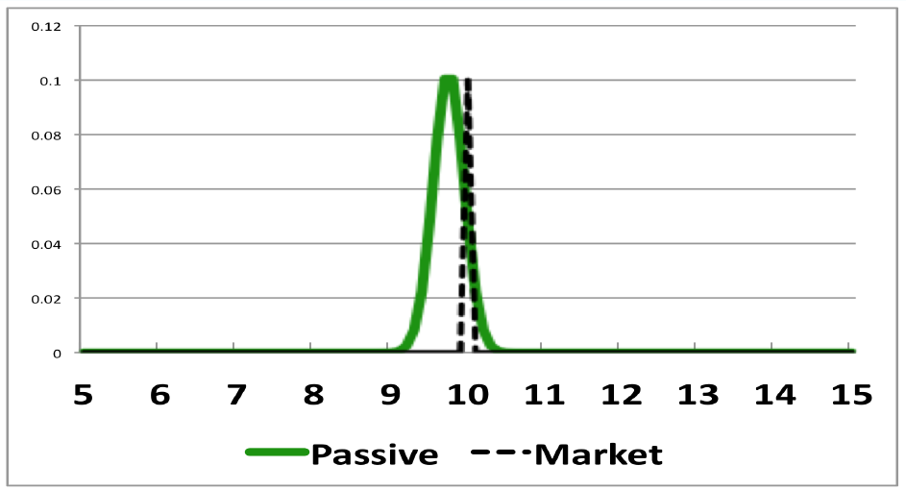
Passive Returns form a Tight
Distribution around the Market Return

Slide 23
Active Investors
Since active investors + passive investors = Market
….. and passive investors, by definition, get the market return (less costs) …..
….. therefore active investors in aggregate must also get the market return (less costs)
Assume market return = 10% pa
  Same as passive investors
But … active costs and distributions are very different from passive investors

Slide 24
Higher Costs for Active Investors
Costs are higher for an active investor
  Must pay for more research
  Trades more often (with other active investors)
    Higher transaction costs
  Higher bid/ask spreads than index funds
    Thinner markets than index funds
  Higher expense ratio than index funds
  Extreme case for hedge funds; 2.0% pa + 20% of profit
John Bogle’s estimate of the average all-in investment expense for an active fund = 2.27% pa
Assume 2.0% pa average total cost

Slide 25
Wide Distributions for Active Investors
Distributions are wider for active investors
  Aiming for diverse targets with broad range of strategies
    Growth stocks, value stocks
    Large cap stocks, small cap stocks
    High dividend stocks, low price/book stocks, etc,
    Momentum plays, contrarian approaches, etc. etc.
  Concentrated portfolios, less diversification
    Want to avoid “closet indexer” slur

Slide 26
Active Returns form a Wide
Distribution around the Market Return
Passive vehicles’ lead in the $11.6 trillion US domestic equity-fund market * (3/2021)
The $6.2 trillion in passive assets still accounts for less than a sixth of the U. S. stock market
*

Slide 27
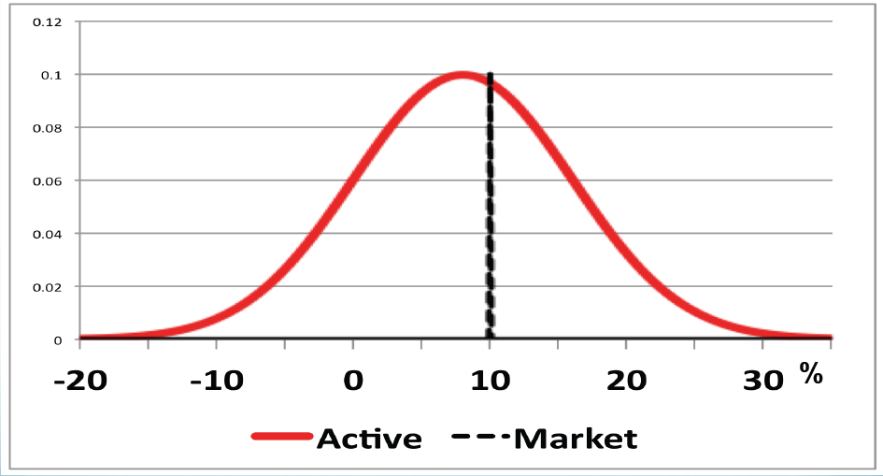
Let’s Compare the Active and
Passive Return Distributions
%

Slide 28
Active Trades
Since active investors must get the market return on average (before costs)
    Half the active investors will beat the market
    and half will do worse than the market
For every trade an active investor makes
    Either he will prove to be a winner beating the market,
    and the guy on the other side of the trade will prove to be a loser …..
    Or he will be the loser
Unlike the children in Lake Wobegon, not all active investors can be above average

Slide 29
Questions to Ask Yourself for Every Trade
Do I have any advantage over the other guy?
Am I smarter than the other guy?
Do I have access to better data?
Do I have better resources for research?
Am I feeling lucky today?

Slide 30
Consider Both Sides of The Trade
Who is on the other side of the transaction?
  Pension plans, Endowment plans
  Mutual funds, Exchange traded funds
  Individual investors: Smart
  Not so smart
Asymmetric information risk
  Probability that an institutional investor on the other end of a trade knows something you don’t know
  How much would you bet on a tennis match if your opponent was a full time professional? Charlie Ellis
What is the probability of your trade proving to be a winning one?
  Are there enough “not so smart” investors to take the other side of your trade?

Slide 31
The Frustrating Law of Active Management
“For any disciplined investment approach to outperform over the long run, it must experience periods of underperformance in the short run”
Hoffstein and Siebers, 2017
In practice:
  For a strategy to outperform in the long run, it must underperform in the short run causing the weak hands to fold, and pass alpha to those who hold.
  Even if we do everything right, we still have to underperform from time to time.
  Applies to all publicly known strategies

Slide 32
A Paradox
If a passive strategy is low cost and efficient, why would anyone follow an active strategy?
  Why not just accept a free ride?
But if everyone adopts a passive strategy, and no one does any security analysis, what brings about the efficiency of the market?
Active investors: Keep up the good work!
  We need you to continue your analysis, and trading amongst yourselves, to maintain an efficient market.

Slide 33
What about History?
Beware back-test data and data mining
  Beware of survivor bias in data
Be aware of mean reversion
With hindsight its easy to find actively managed funds that have outperformed the market in the past
The challenge is to identify them going forward and to recognize quickly when they fail to outperform
“All strategies work until they don’t work”
  By the time you’ve figured out it’s time to switch to a new strategy it’s too late
“There are lies, damn lies, and statistics!” Be careful!

Slide 34
Opinions on Predicting the Future
Past performance is no guide to future returns.
To beat the market you have to be able to predict the future. (Harry Domash opinion)
To beat the market you have to predict the future better than everyone else. (Fred Smith opinion)
  If you predict the same future as everyone else you get the same market returns as everyone else.
We can’t predict the future, but we can prepare for it. (Fred Smith opinion)

Slide 35
Fred’s Folly (opinion)
All successful investing strategies lead to comparable long-term risk adjusted returns.
Building a diversified portfolio of cheap index funds is a successful long-term strategy giving the market return.
Therefore all successful long-term strategies lead to the market return, including active strategies.

Slide 36
A Perspective on Pension Funds
US state and local government funds
  Go anywhere diversified portfolios including hedge funds, private equity, etc.
Average returns for past 20 years: 7% pa
  Projected future returns: 6%
CALPERS 6/2022-6/2023 net return 5.85%
Many pension funds, including CALPERS, are switching significant portions of their portfolios to passive index management.

Slide 37
Who Should Be an Active Investor?
You should consider being an active investor if …
  You are smarter than the average investor, including the professionals
  You have access to better data, better tools, other resources
  You are prepared for the inevitable periods of underperformance
  You enjoy the challenge
  You don’t mind giving up weekends
  You consider yourself luckier than most

Slide 38
Who should be a Passive Investor?
You should consider being a passive investor if …
  You are comfortable earning the market return
  You are happy knowing that your strategy beats about two-thirds of all other investors
  You can stay-the-course in spite of occasional major downturns
  You enjoy spending your weekends fishing rather than sitting in front of a computer
  You like to know that you can relax on safari for a month without worrying about what the market is doing
  Think Boring Is Good

Slide 39
For Those Who Can’t Decide
How about a “Core and Explore” compromise?
Core:
  Use passive index strategy for 80% of portfolio
Satellite:
  Use active strategy for remaining 20% of portfolio
  Important to keep costs down
  Track the long-term performance of both sections carefully

Slide 40
Listen to What The Wise Men Say
  The stock market can stay irrational longer than you can stay solvent. John Maynard Keynes
  Are you smarter than the average professional investor? Probably not. Bill Sharpe
  If you must play the market to satisfy an emotional itch, recognize that you are gambling on your ability to beat the pros. So limit the amounts you play with to the same amounts you would gamble with the pros at Las Vegas. Charlie Ellis
  The role of stock forecasters is to make fortune tellers look good. Warren Buffet
  Forget the needle, buy the haystack. Jack Bogel

Slide 41
To Probe Further
Making Sense of Investment Risk, Paul Merriman, AAII Journal, March 2020
Rebalancing: A Sound Strategy for Limiting Risk, Vanguard, June 2019
Global Equity Investing, The Benefits of Diversification and Sizing Your Allocation, Vanguard, February 2019
The Frustrating Law of Active Management, Corey Hoffstein et al., Newfound Research LLC, October 2, 2017
Portfolio Selection, Harry Markowitz, Journal of Finance, 1952
A Random Walk Down Wall Street, Burton Malkiel, Norton & Co.
Winning the Loser’s Game, Charles Ellis, McGraw-Hill
Investing at Level 3, James Cloonan, AAII

Slide 42
Useful Websites
http://aaii.com Broad selection of investing material
http://siliconvalleyaaii.org Previous presentations on various topics
https://sccld.org/resources/business/ Business & Money
  Morningstar Research Center, S&P’s NetAdvantage, Value Line
https://portfoliovisualizer.com Free access to a wide selection of tools
https://vanguard.com https://fidelity.com https://schwab.com
http://scallan.com Callan chart
http://bogleheads.org Interesting blog
https://obliviousinvestor.com/index-funds/ Mike Piper blog
https://rickferri.com/investment-philosophy/ Rick Ferri blog
https:/muscularportfolios.com Brian Livingston

Slide 43
